Slide 1
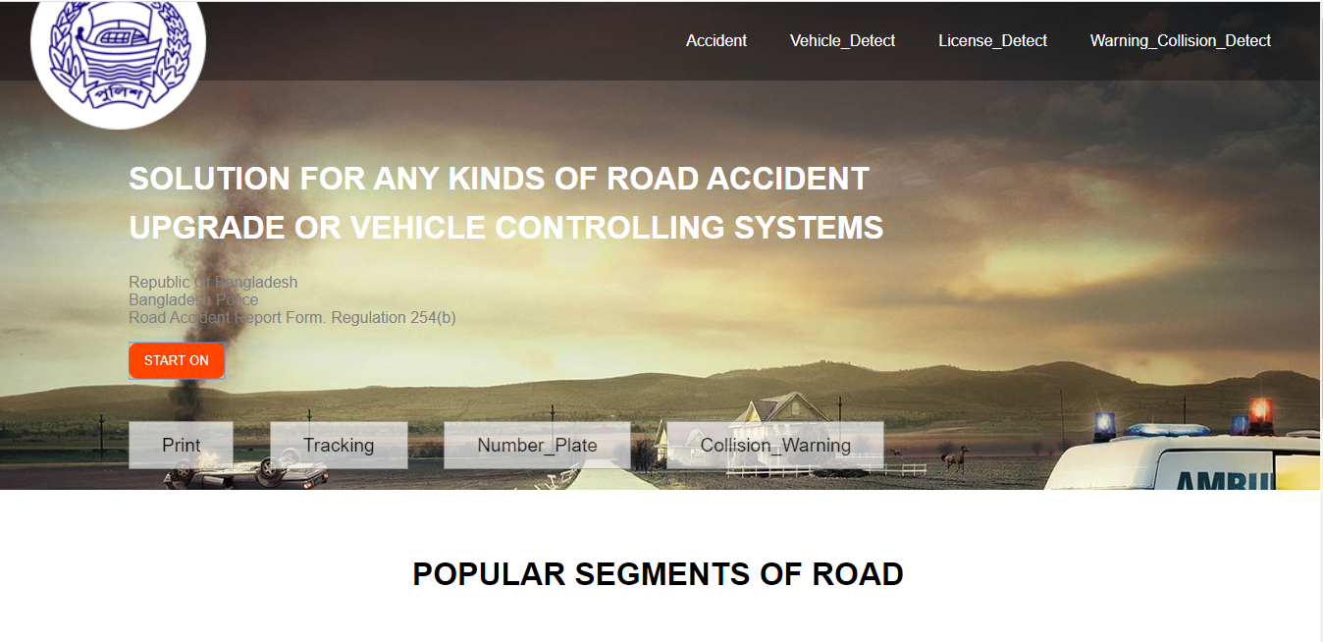
ROAD TRANSPORTATION MANAGEMENT SYSTEM
Project Based On Neural Network Through Road Transportation and also Accident Data Collective Information

Slide 2
Research BACKGROUND:
Accident Information:-
Accident based software or the data collecting information is About where the accident happened or where the accident took place about the location tracking through Google map. The accident conditions how it happens with route map and description, vehicle's crashing information, injured passenger, injured and death number, reason behind accident etc.

Slide 3
Vehicle Detection with through CCTV Footage(Neural Network):-
How many vehicles are passing every day and how they over crossing one with on another. Maintaining the road lane detection either or not any police traffic controller or the admins can easily watch that through monitoring through CCTV footage.

Slide 4
License Detect Through CCTV Footage(Neural Network):-
which vehicle’s are crashed with each other and how many vehicle’s over there and their license number plate detection through wireless device through mobile phone or alarming systems alert we will show in our project.

Slide 5
Warning Collision systems(Neural Network):-
Over excessive horn or traffic jam like much more vehicles in one place are quite pathetic so for road safety traffic police, or In police systems easily you can check where the collision happens and reduce it urgently through software

Slide 6
WEBSITE DESIGNED :

Slide 8
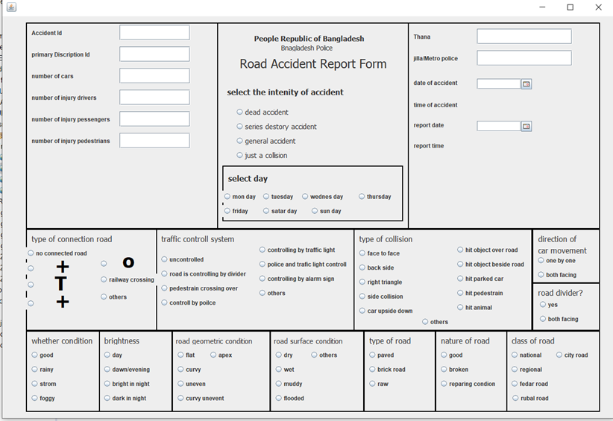
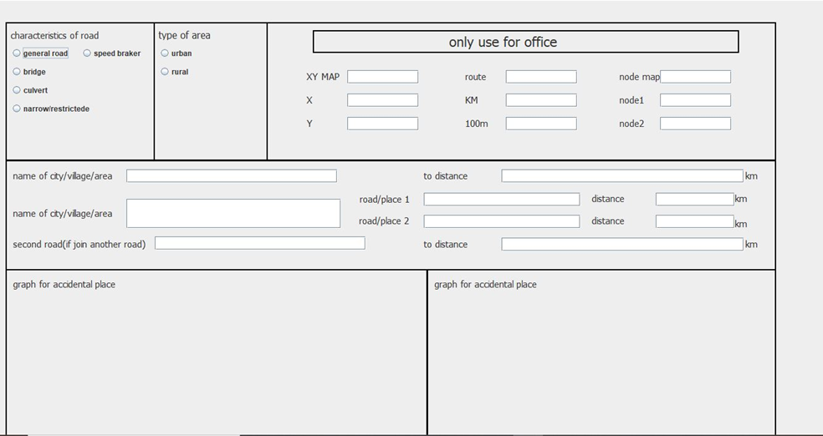
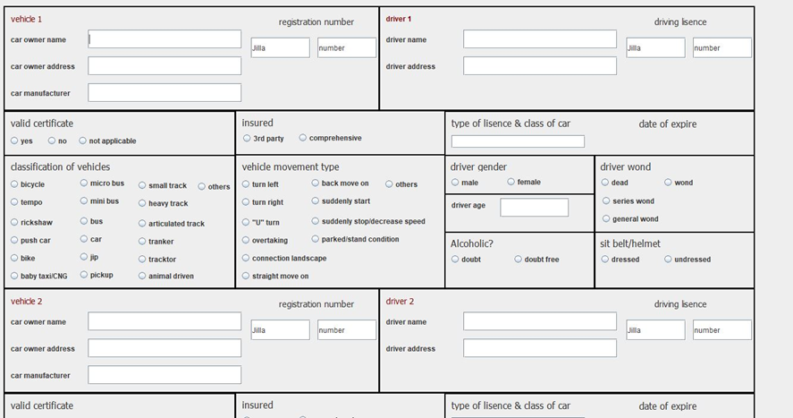
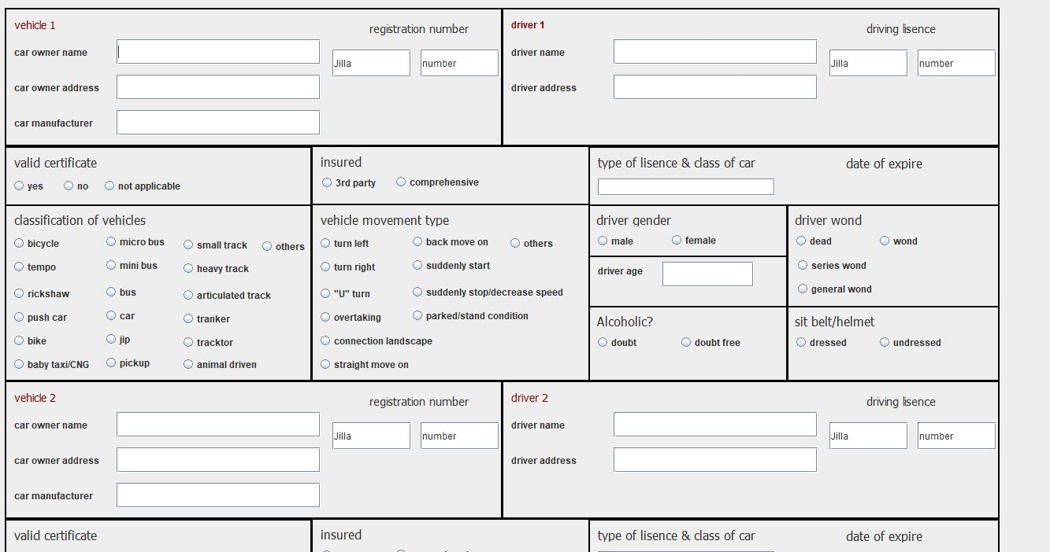

Slide 9
Automatic signal alert/Vehicle alert on a curve/ HILLY road:
Our system will use sensors to detect any vehicles reaching hair pin bend ( curve ) and alerts immediately on other side vehicles by red signal and also producing alert sound. If hair pin bend road is clear green signal is produced. Thus this system provides safety for drivers to prevent hill side accidents and ride safely in hill side roads.

Slide 10
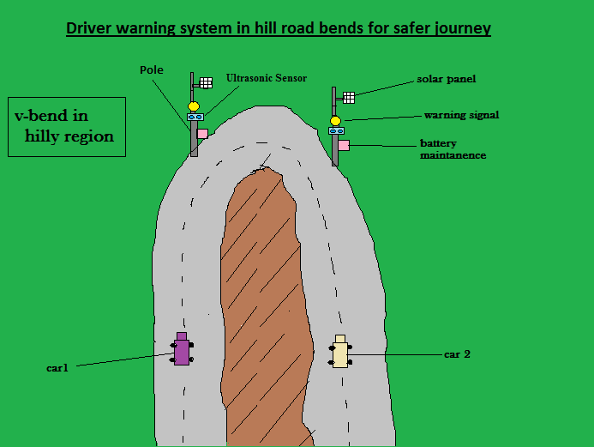
Two poles are placed at the ends of the curve in hill bends.
Ultrasonic sensors are fixed on each pole which senses the incoming vehicles towards the pole and sends information to Arduino UNO controller board.
Warning signal lights are fixed to each pole connected with Arduino UNO controller board.
Arduino UNO makes the warning signal glows brighter according to the program, when the vehicles approach near to the bend in hill road.

Slide 11
Real Time Multiple Object Detection: YOLO WITH Opencv :

Slide 12
What is the YOU ONLY SEE ONCE (YOLO) object detector?
When it comes to deep learning-based object detection, there are three primary object detectors. YOLO is one of them. YOLO is a great example of a single stage detector.
single-stage detectors tend to be less accurate than two-stage detectors but are significantly faster.
YOLO has several advantages over classifier-based systems. It makes predictions with a single network evaluation unlike systems like R-CNN which require thousands for a single image. This makes it extremely fast, more than 1000x faster than R-CNN and 100x faster than Fast R-CNN.
YOLO system for detecting objects LIKE : Person, bird, cat, cow, dog, horse, sheep , aero plane, bicycle, boat, bus, car, motorbike, train, bottle, chair, dining table, potted plant, sofa, tv/monitor

Slide 13
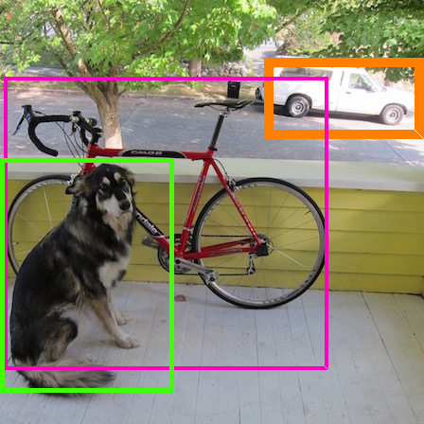
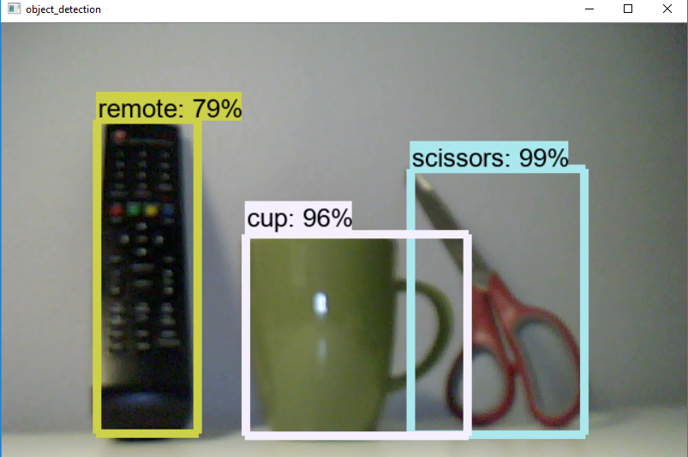
Real-Time Detection PICTURE :

Slide 14
Vehicle number plate Detection:-
Abstract :-
Moving object detection is an important process in most video-based applications such as video surveillance, traffic monitoring, human motion capture, etc. Background subtraction and color image segmentation methods are widely used for detecting moving objects in a video stream that help detecting features of the moving object for further video processing. In this paper, moving object detection system is proposed based on both background subtraction, color segmentation, license plate recognition methods. This method builds a background model and normally distributed each pixel in the image sequences and calculating the difference between each image in the sequence and this background model for foreground extraction and detecting movement areas from the background model and then the background model is updated. Color segmentation is applied to separate features based on colors. The system detects vehicles enter parking gate and allow only a specific vehicle type depending on vehicle color and license plate. License plate recognition depending on vehicle type is implemented after color segmentation. Experimental results of implementing the proposed method using video sequences provided by surveillance camera show superior performance and the system detects moving objects successfully

Slide 15
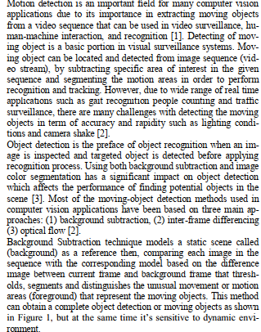
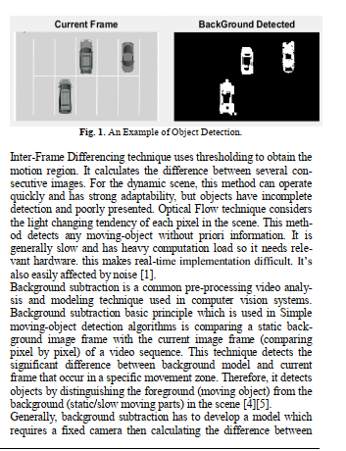
Introduction:-

Slide 16
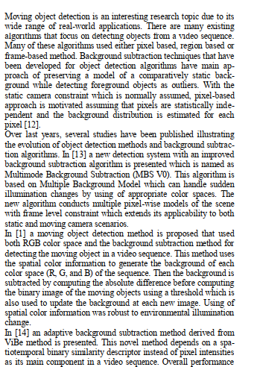
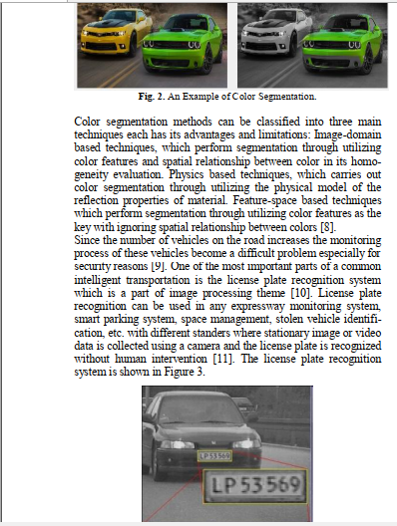
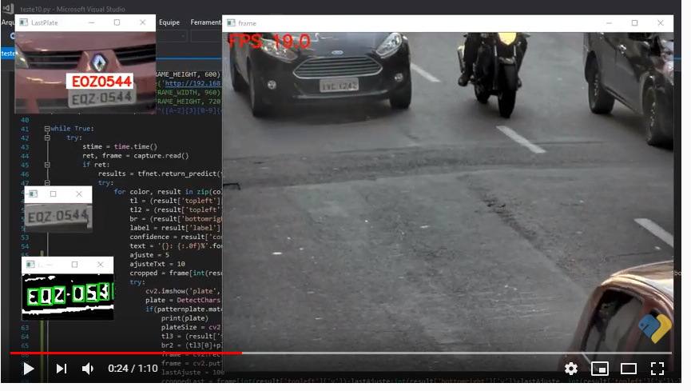
Related Work :-

Slide 17
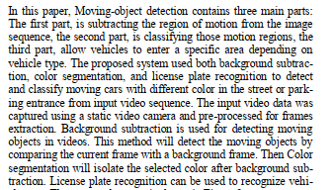
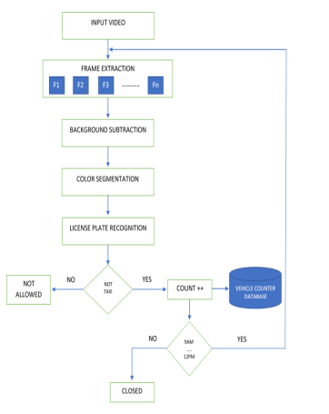
The Proposed System :-

Slide 18
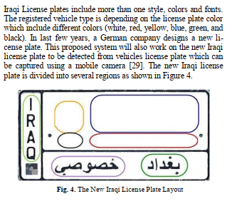
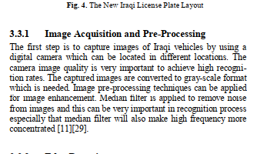
License Plate Recognition:-

Slide 19
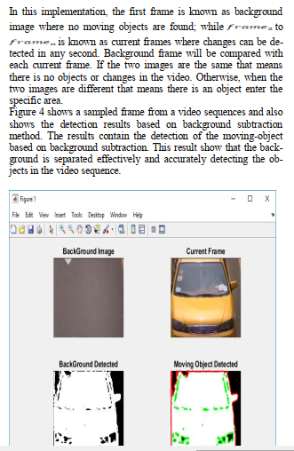
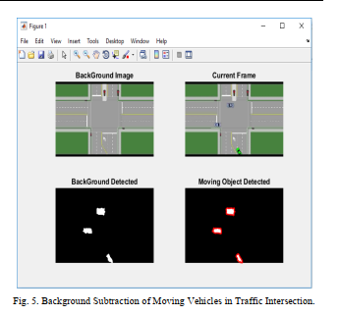
Implementation of Background Subtraction :-

Slide 20
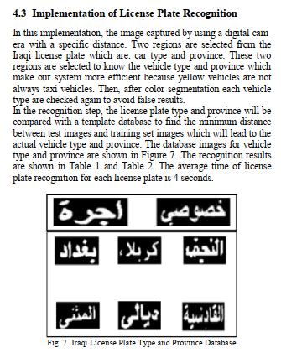
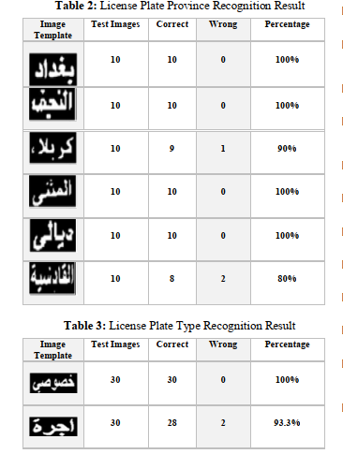
Implementation of License Plate Recognition :-

Slide 21
THANK YOU

